Slide 1
Deterministic Negotiations: Concurrency for Free
Javier Esparza
Technische Universität München
Joint work with
Jörg Desel and Philipp Hoffmann

Slide 2
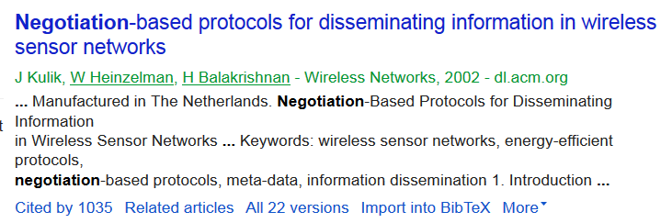
(Multiparty) negotiation

Slide 3
Negotiation as concurrency primitive
Concurrency theory point of view:
Negotiation = synchronized choice
CSP: $\left(aP_{1}+bP_{2}\right) \left|\left\{a,b\right\}\right| (aQ_{1}+bQ_{2})$
Petri nets:
a
b
Negotiations: a net-like concurrency model with negotiation as primitive.

Slide 4
The Father-Daughter-Mother Negotiation
Daughter
Agents
Initial states
Father
11:00 pm
Daughter
2:00 am
Mother
10:00 pm

Slide 5
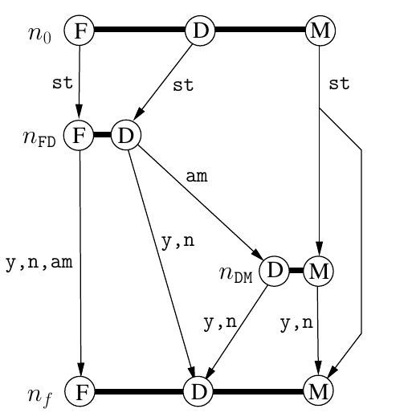
The Father-Daughter-Mother Negotiation

Slide 6
The Father-Daughter-Mother Negotiation
Atomic negotiations
(atoms)

Slide 7
The Father-Daughter-Mother Negotiation
Initial atom
Final atom

Slide 8
An atomic negotiation
Parties:
subset of agents
Outcomes:
yes, no,
ask_mum
Outcomes:
yes, no,
ask_mum
Outcomes:
yes, no,
ask_mum
State transformers (one per outcome):
$$T_{am}\left(tf,td\right)=(tf,td)$$
$${ T}_{y}\left(tf,td\right)=\{(t,t) | tf ≤ t ≤ td\}$$

Slide 9
Semantics
11:00
2:00
10:00
11:00
2:00
10:00
12:00
12:00
10:00
12:00
12:00
12:00

Slide 10
Semantics
11:00
2:00
10:00
11:00
2:00
10:00
11:00
2:00
10:00
11:00
Angry!
Angry!
Beer!
Angry!
Angry!

Slide 11
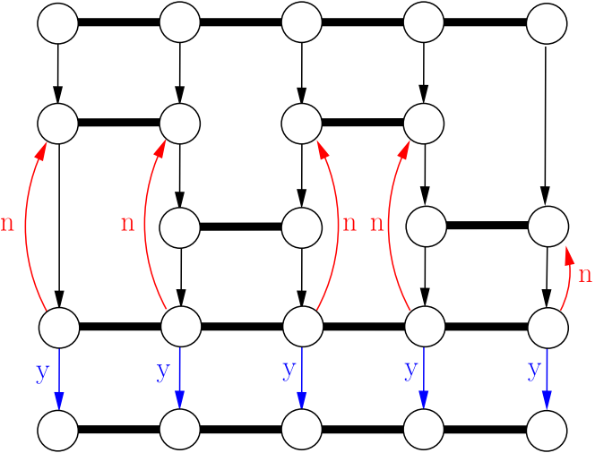
Negotiations as Parallel Computation Model. Parallel Bubblesort
5
2
7
1
3
Four agents.
Internal states: integers.
Transformer of internal binary atom: swap integers if not in ascending order.
$$T\left(x,y\right)=if y<x$$
$$then \left(y,x\right)$$
$else (x,y)$

Slide 12
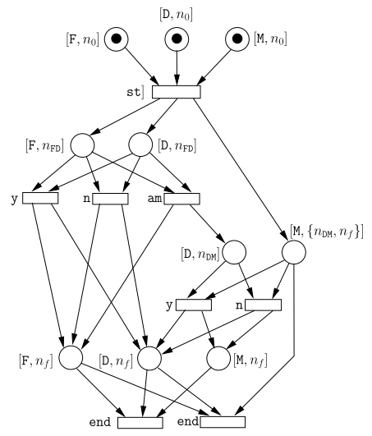
Negotiations and Petri nets
Negotiations have the same expressive power as (coloured) 1-safe Petri nets, but can be exponentially more succint.

Slide 13
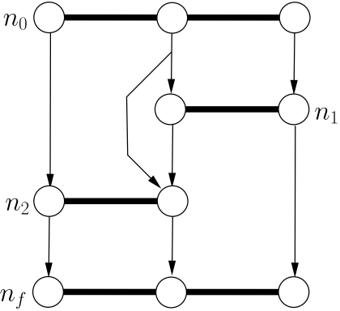
Analysis problems: Soundness
Deadlock!

Slide 14
Analysis problems: Soundness
Large step: sequence of occurrences of atoms starting with the initial and ending with the final atom.
A negotiation is sound if
Every execution can be extended to a large step.
No useless atoms: every atom occurs in some large step.
(cf. van der Aalst’s workflow nets)
In particular: soundness → deadlock-freedom

Slide 15
Analysis problems: Summarization
Each large step induces a relation between initial and final global states
The summary of a negotiation is the union of these relations (i.e., the whole input-output relation).
The summarization problem consists of, given a sound negotiation, computing its summary.

Slide 16
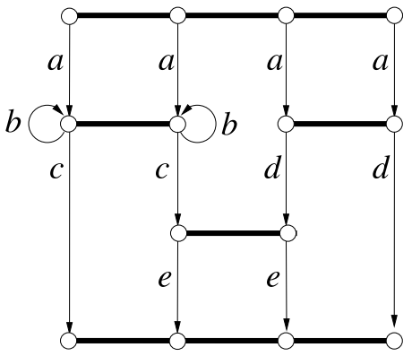
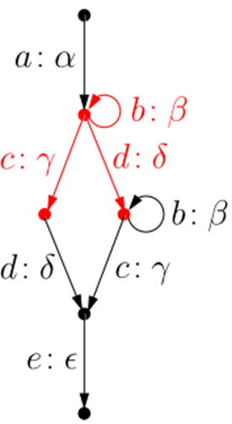
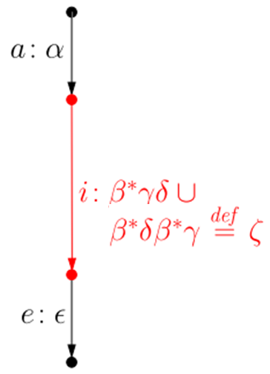
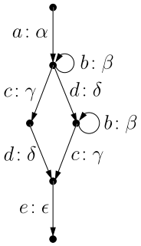
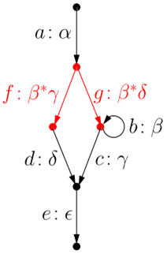
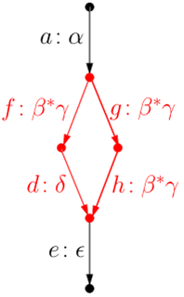
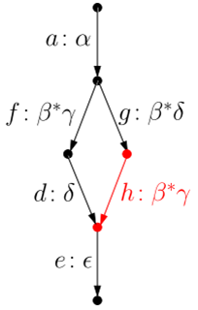
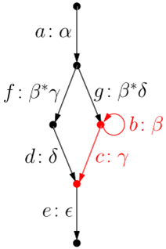
Computing summaries
A simple algorithm to compute a summary:
Compute the LTS of the negotiation
Apply reduction rules
$$a:α$$
$$b:β$$
$$…$$
$$e:ε$$
State explosion!
$$a:α$$
$$a:α$$
$$b:β$$
$$c:γ$$
$$a:α$$
$$b:β$$
$$b:β$$
$${d:α}^{∗}β$$
$$e:α^{∗}γ$$
$$c:αβ$$
$$c:α∪β$$
Iteration
Shortcut
Merge

Slide 17
Computing summaries
Theorem [CONCUR 13]: deciding if a giving pair of global states belongs to the summary of a given negotiation is PSPACE-complete, even for every simple transformers.
Restriction to:
DETERMINISTIC NEGOTIATIONS

Slide 18
Deterministic negotiations
A negotiation is deterministic if no agent is ever ready to engage in more than one atom
Graphically: no proper hyperarcs.
non-deterministic

Slide 19
Deterministic negotiations
A negotiation is deterministic if no agent is ever ready to engage in more than one atom
Graphically: no proper hyperarcs.
deterministic

Slide 20
Det. Negotiations: Reduction Rules
Aim: find reduction rules acting directly on negotiation diagrams (instead of their transition systems).
Rules must:
preserve soundness: sound after iff sound before; and
preserve the summary: summary after equal to summary before
In [CONCUR 13] we present three local rules: application conditions and changes involve only a local neighbourhood of the application point.

Slide 21
Rule 1: Merge
$a:α$,
$b:β$
$$a:α$$
$$b:β$$
$$a,b$$
$$a,b$$
$$a,b$$
$$c:α∪β$$
$$c$$
$$c$$
$$c$$
$$c:α∪β$$

Slide 22
Rule 2: iteration
$$a$$
$$a:α$$
$$a$$
$$a$$
$$a:α$$
$$b:β$$
$$c:γ$$
$$b:β$$
$$c:γ$$
$$b$$
$$c$$
$$b$$
$$c$$
$$b$$
$$c$$
$$e:α^{∗}γ$$
$$d:α^{∗}β$$
$$e:α^{∗}γ$$
$$d:α^{∗}β$$
$$d$$
$$e$$
$$d$$
$$e$$
$$d$$
$$e$$

Slide 23
Rule 3: shortcut
Orange atom enables white atom uncondi-tionally.
$$a:α$$
$$a$$
$$a$$
$$a$$
$$a:α$$
$$b:β$$
$$b:β$$
$$b$$
$$b$$
$$c:αβ$$
$$c$$
$$c$$
$$c:αβ$$
$$c$$
$$b$$
$$b$$

Slide 24
Completeness and polynomiality
A set of rules is complete for a class if it reduces all negotiations in the class to atomic negotiations.
A complete set of rules is polynomial if every sound negotiation with k atoms is reduced to an atom by $p(k)$ rule applications, for some polynomial p.

Slide 25
The Reducibility Theorem
Theorem [CONCUR 13,FOSSACS 14]:
The shortcut, merge, and iteration rules are
complete and polynomial for deterministic negotiations
(Also; extension to acyclic, weakly deterministic negotiations, like the Father-Daughter-Mother neg.)
Concurrency for free:
Soundness decidable in polynomial time.
Summarization as complex as in the sequential case. No additional „exponential“ due to state explosion.

Slide 26
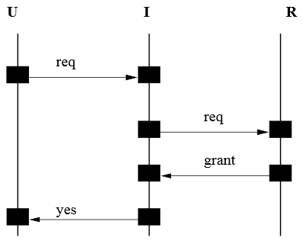
Scenarios/Choreographies
Scenario: Concurrent run of the system (use case)
„Global view“ of an execution.
Message-passing
Message Sequence
Chart
Source: Harel

Slide 27
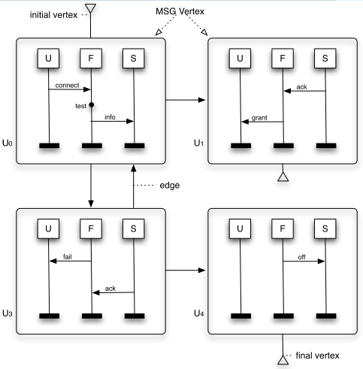
Scenario-based Specifications
Specification: „regular set“ of scenarios
Message-passing
Message Sequence
Graph
Source: Bille and Kosse

Slide 28
Scenario-based Specifications
Implementation: communicating automata
Message-passing
Channel systems
Source: Schnoebelen

Slide 29
The Realizability Problem
Given a specification, automatically compute a realization (implementation), if there is one.
Message-passing
[Alur et al. 01]
Not every specification is realizable
Realizability is undecidable
Deadlock-free realizability in EXPSPACE and PSPACE-hard

Slide 30
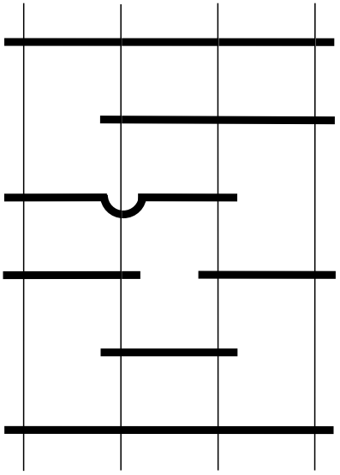
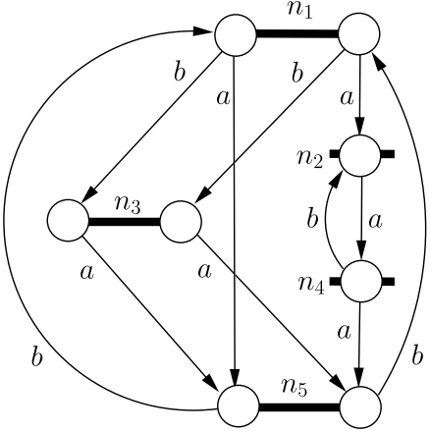
Realizability for Deterministic Negotiations
Scenario
Mazurkiewicz trace
Implementation
Det. Negotiation
We design a programming language for deterministic negotiations
A
B
C
D
And the specification model ?
$$a$$
$$b$$
$$c$$
$$d$$
$$e$$
$$f$$

Slide 31
Negotiation programs
A negotiation program $P$ is defined over:
a set $AG(P)$ of agents, and
a set $AC\left(P\right)$ of actions
Each action $a$ is jointly executed by a subset $AG\left(a\right)⊆AG(P)$ of the agents of $P$
(cf. distributed alphabets)

Slide 32
Negotiation programs
A negotiation program $P$ is either:
the empty program $ε$

Slide 33
Negotiation programs
A negotiation program $P$ is either:
the empty program $ε$
a do-od block
do [] $a_{1}:P_{1}$ end … [] $a_{k}:P_{n}$ end
[] $a_{k+1}:P_{n+1}$ loop … [] $a_{k+ℓ}:P_{n+ℓ}$ loop
od
$$AG\left(a_{i}\right)=AG(P)$$
$$AG\left(P_{i}\right)⊆ AG(P)$$

Slide 34
A programming language
A negotiation program $P$ is either:
the empty program $ε$
a do-od block
do [] $α_{1}:P_{1}$ end … [] $α_{k}:P_{n}$ end
[] $α_{k+1}:P_{n+1}$ loop … [] $α_{k+ℓ}:P_{n+ℓ}$ loop
od
$$AG\left(P\right)=AG\left(P_{1}\right)∪AG\left(P_{2}\right)$$
a layered composition $P_{1}∘P_{2}$
[Zwiers et al, early 90s]

Slide 35
Mazurkiewicz trace semantics
We assign a negotiation program $P$ a set $⟦P⟧$ of Mazurkiewicz traces over the program actions
Agents
B
C
D
aa
A
$$a$$
$$b$$
Actions
$$c$$
$$d$$
$$e$$
$$f$$

Slide 36
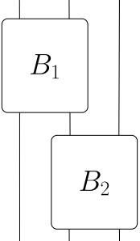
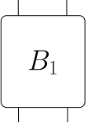
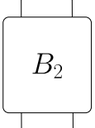
Semantics of layered composition
Semantics of $P_{1}∘P_{2}$ : trace concatenation
$$⟦P_{1}∘P_{2}⟧=⟦P_{1}⟧∙⟦P_{2}⟧$$
Trace of ${P_{1}∘P}_{2}$
Trace of $P_{1}$
Trace of $P_{2}$
A
B
C
A
B
B
C
$$t_{1}$$
$$t_{1}$$
$$t_{2}$$
$$t_{2}$$

Slide 37
Semantics of layered composition
$$a$$
$$a$$
$$a$$
$$b$$
$$b$$
$$c$$
$$c$$

Slide 38
Semantics of blocks
$\begin{matrix}⟦ do { a}_{1}:P_{1} end { a}_{2}:P_{2} loop od⟧ \\ = \\ {\left(⟦a_{2}⟧∙⟦P_{2}⟧\right)}^{∗}∙ (⟦a_{1}⟧∙⟦P_{1}⟧)\end{matrix}$
Abbreviation:
$do  a:ε end od$ → $a$

Slide 39
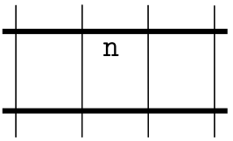
An example

Slide 40
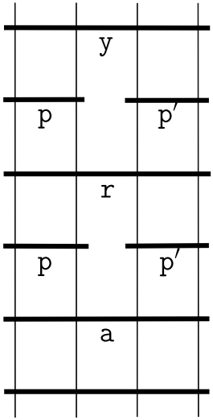
An example

Slide 41
Programming deterministic negotiations

Slide 42
Programming deterministic negotiations

Slide 43
Programming deterministic negotiations

Slide 44
Programming deterministic negotiations

Slide 45
Programming deterministic negotiations

Slide 46
The Realizability Theorem
Theorem (submitted):
For every negotiation program $P$ of size $n$
there is a SOUND det. negotiation $N$ of size $O(n)$
such that $⟦P⟧=⟦N⟧$.
For every SOUND det. negotiation $N$of size $n$ there is a negotiation program $P$of size $O(2^{n^{4}})$
such that $⟦P⟧=⟦N⟧$.

Slide 47
The Realizability Theorem
In realizability terms:
All specifications can be implemented, without blowup, in linear time.
All specifications are sound (and so deadlock/livelock-free).
All sound implementations can be specified.

Slide 48
From negotiations to programs
We use our complete set of reduction rules for sound deterministic negotiations (SDNs).
For every SDN $N$ there is a sequence
$N_{0}, N_{1},N_{2}, …{, N}_{k}$
of negotiations such that
$N_{0}=N$,
$N_{i+1}$ is obtained from $N_{i}$ by applying a rule, and
$N_{k}$ is the negotiation of the empty program

Slide 49
From negotiations to programs
For the reverse sequence
$$N_{k} , N_{k−1} ,N_{k−2} , …, N_{0}$$
obtained by aplying the reverse of the reduction rules (synthesis rules), we construct a matching sequence of programs
$$P_{k} , P_{k−1} ,P_{k−2} , …, P_{0}$$
such that $⟦P_{i}⟧=⟦N_{i}⟧$ for every $1≤i≤k$

Slide 50
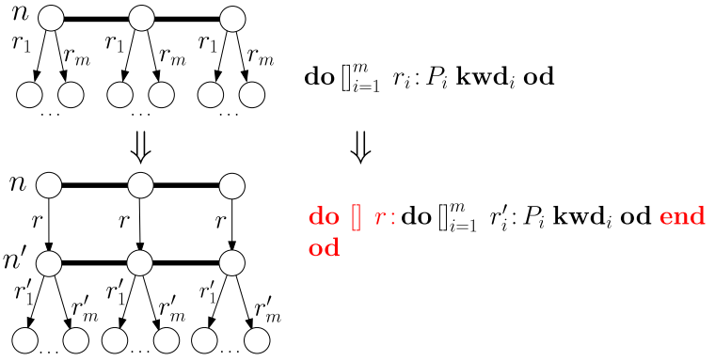
From negotiations to programs
Shortcut rule, case 2

Slide 51
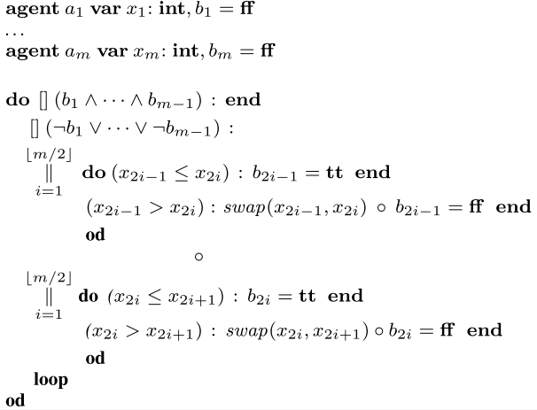
Parallel bubblesort

Slide 52
Open questions
Complexity bounds:
Open: Tight bounds for the number of rule applications.
Beyond nondeterminism: weak determinism
So far: complete sets of rules for some cases
Open: complexity of soundness
Negotiation games (submitted):
Polynomial algorithms for coalition games (with Philipp Hoffmann)
Open: Extensions to weak determinism
Probabilistic and stochastic extensions:
Conjectured: polynomial algorithms for computing expectations and probabilities

Slide 53
Open questions
Negotiations as a subclass of asynchronous automata
Open: characterization of their trace languages
Application to „deterministic workflow nets“
Open: complete set of reduction rules
Hoare logic for negotiation programs
Open: Precise definition, completeness

Slide 54
Two (new?) buzzwords?
Concurrency for free / Low-cost Concurrency:
Do not ask: Is this extension still decidable?
Do ask: Which fragment is in PTIME? In NP?
Det. Negotiations: „perfect core“, starting point to study extensions
Bootstrap verification
Property $X_{i}$ easier to prove for systems satisfying properties $X_{1},…, X_{i−1}$

Slide 55
That‘s it
Before we negotiate, I have to tell you
I‘ll take any offer.
Homer Simpson

